Slide 1
Linear Regression with Multiple Variable
Overview:
Single Variable Linear Regression
Multiple Variable Linear Regression
Single vs Multiple
Cost Function
Gradient Decent
Accuracy
R2 Value
Implementing with Python

Slide 2
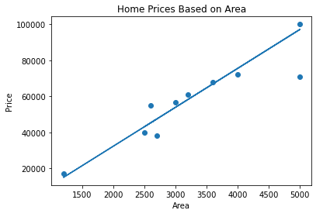

All about Single Linear Regression
y = mx + b ; or,
Y = 21.43* X + 4980.13
Best Fit Line
1
Coefficient = 21.43
Intercept = 4980.13

Slide 3
All about Single Linear Regression

Slide 4
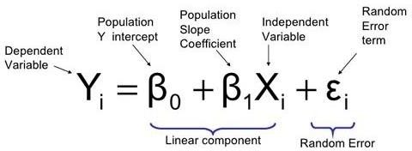
All about Single Linear Regression
y = mx + b + error
y = b + mx + error

Slide 5
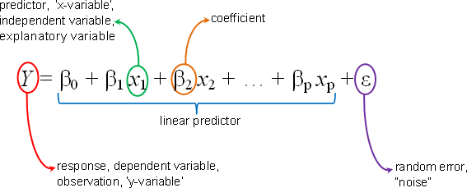
Linear Regression with Multiple Variable
Multiple

Slide 6
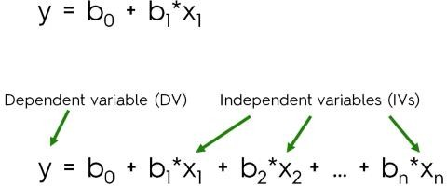
Linear Regression with Multiple Variable
Single
Multiple

Slide 7
R Squared Value
^{𝑛−1} Predicted Value ( Yp ) – Mean Value ( Y )
=෍
R Squared Value
Actual Value ( Y ) – Mean Value ( Y )
𝑖=0
= Something * 100
Accuracy = Something %
Abu Bakar Siddique Mahi

Slide 8
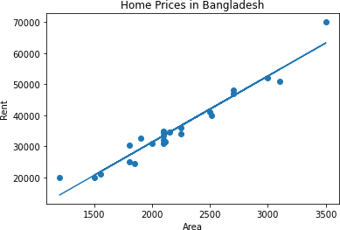

R Square Value
Y_pred = reg.predict(xtest) #Predicted Y
R2 Score: from sklearn.metrics import r2_score
Score = r2_score(ytest, Y_pred)

